Slide 1
THE WHISTLEBLOWING GUIDE : SPEAK-UP ARRANGEMENTS, CHALLENGES AND BEST-PRACTICES

Slide 2
Overview
Week 1: Introduction to Whistleblowing
Week 2: Speak Up Arrangements- what we know so far
Week 3: Internal and External Whistleblowing
Week 4: Trust in Organizations
Week 5: How Do People Speak Up?
Week 6: Best Practice in Speak-up Arrangements
Week 7: Responsiveness
Week 8: Using Speak-up Data

Slide 3
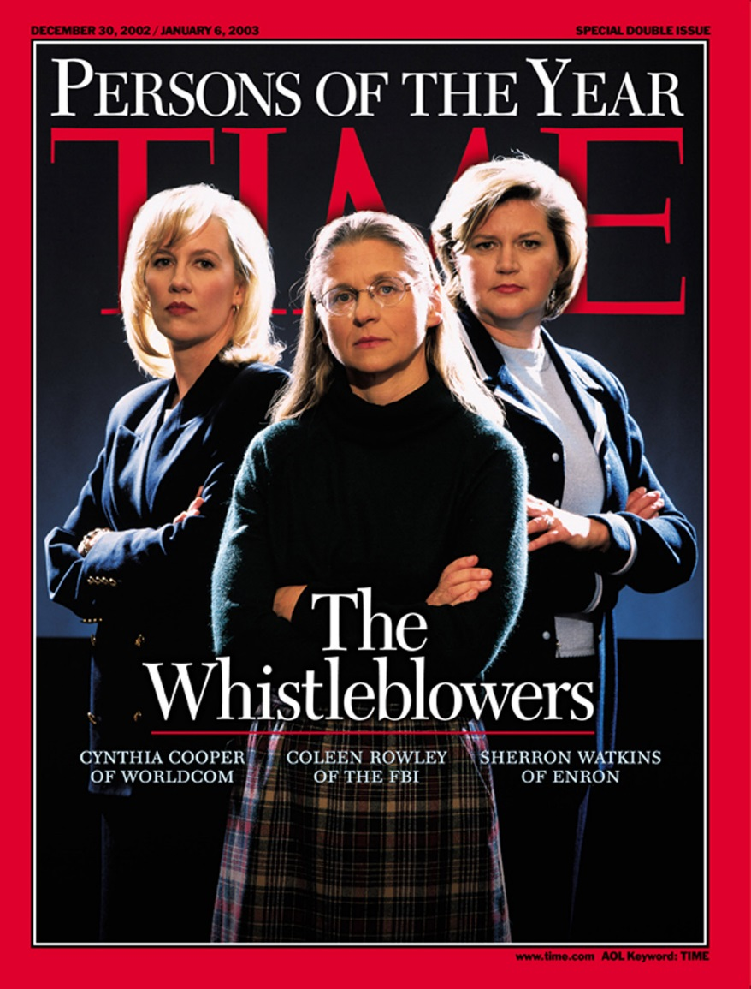
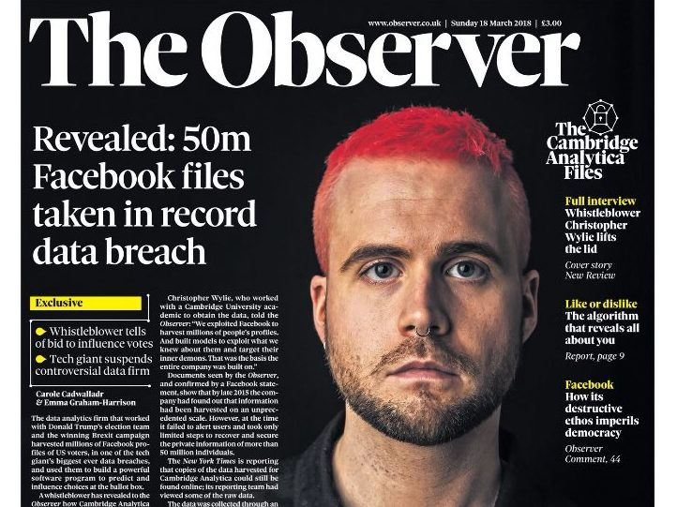
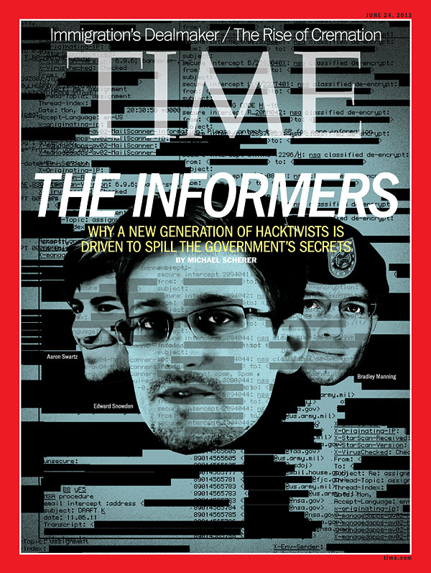
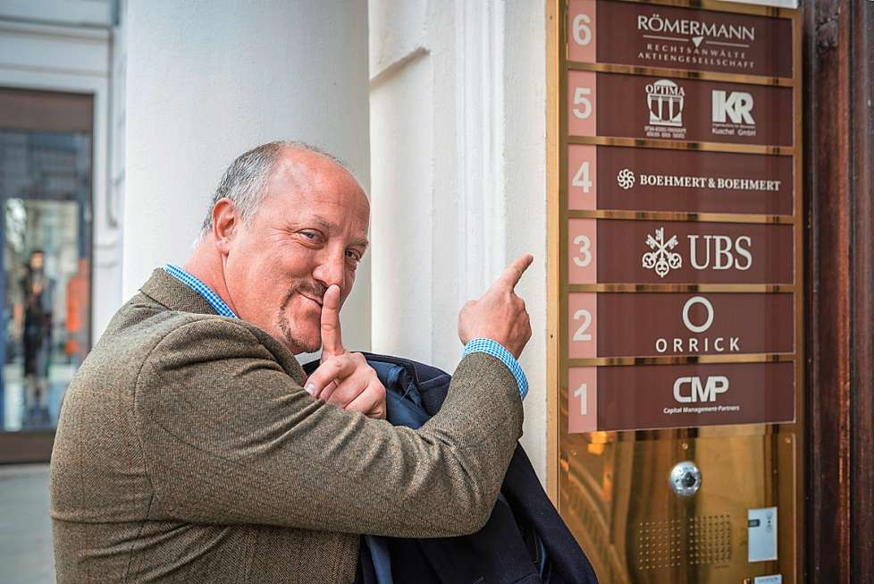
Introduction to Whistleblowing
Notes:
Questions to ask:
Can you name any famous whistleblowers?
When I say whistleblowing what comes to mind?
Why should we care about whistleblowing?
Images are of: (L) Cynthia Cooper, Coleen Rowley and Sherron Watkins; (Mid Top) Christopher Wylie of Cambridge Analytica; (Mid Bot); Bradley Birkenfeld; (L) Aaron Swartz, Edward Snowden and Bradley Manning (now Chelsea Manning).
https://www.youtube.com/watch?v=WXUrYlFEZ08 – (talk on how you can’t have whistleblowing without the truth.)
Whistleblowing is a phenomenon in organizations that is increasing in frequency.
Sometimes whistleblowers are portrayed as heroes (Grant, 2002), sometimes they are portrayed as villains (Rothschild and Miethe, 1999) and sometimes they are portrayed as both. See Kenny 2019 for discussion.
A recent study of over 5,000 firms shows that 40% of companies surveyed suffered from serious economic crimes that averaged over $3 million each in losses. Whistleblowers exposed 43% of these crimes, which means that whistleblowing was more effective than all the other measures combined: corporate security, internal audits and law enforcement.
ACFE. (2018). Report to the Nations: 2018 Global Study on Occupational Fraud and Abuse. Available at: https://s3-us-west-2.amazonaws.com/acfepublic/2018-report-to-the-nations.pdf [accessed 14 June 2018].
So regardless of whether they are good or bad, we know that they are effective.

Slide 4
What is Whistleblowing?
‘the disclosure by organization members (former or current) of illegal, immoral, or illegitimate practices under the control of their employers, to persons or organizations that may be able to effect action’ (Near and Miceli 1985: 4).
one who ‘speaks out about illegal or unethical behavior within his or her organization’ (Alford, 1999: 266), and who experiences retaliation as a result (Alford, 2007).
Notes:
While there is not agreement about the definition of whistleblowing, there are a few definitions that are frequently used.
The first poses that any disclosure about wrongdoing counts as long as it is made to someone that can do something about it
This definition allows for ‘successful whistleblowing’ where someone can speak up and the issue can be dealt with
Eg compliance officers, auditors etc
The second definition holds that it is not whistleblowing until there is a negative reaction from the organization, otherwise it is just business as usual.
This seems to fit with whistleblowing in practice, a compliance officer that is just doing her job would rarely identify herself as a whistleblower.
The difference between these two definitions point to the whistleblower identity – on becomes a whistleblower when they realize/are told that they are one

Slide 5

Whistleblowing Research
Much of the whistleblowing research is quantitative and focuses on
  Who blows the whistle?
  Motivation for whistleblowing
  Large survey studies
Theoretical approaches include
  Whistleblowing as prosocial behaviour
  Whistleblowers as moral saints
  Whistleblowers as disloyal organization members
Notes:
For a useful overview of why we should care about whistleblowing see Near, J, & Miceli, M 2016, 'After the wrongdoing: What managers should know about whistleblowing', Business Horizons, 59, pp. 105-114
Theories of whistleblowing include
Whistleblowing as pro-social behaviour (Miceli et al., 2008)
Whistleblowers as moral saints (Grant 2002)
Whistleblowers as disloyal organization members (Rothschild and Miethe, 1999)
Whistleblowing as affective recognition (Kenny, 2019)
Whistleblowing as organizational resistance (Alford, 2001)
Research on Motivation
Religion (Glazer and Glazer, 1989)
Financial gain (Faunce et al., 2014)
Influence of family (Kenny, 2015; 2019)
Survey Studies:
Australian Public Sector (Brown, 2008)
Meta-analysis of previosu research (Mesmer-Magnus & Viswesvaran, 2005)
United States Miceli et al., 2008
Ireland (Transparency International 2017)
Financial costs of whistleblowing (ESRC 2019)

Slide 6

Whistleblowing in Practice
Whistleblowing Laws
  Do they work?
Company whistleblowing policies
  Do they have them?
Notes:
Near, J, & Miceli, M 2016, 'After the wrongdoing: What managers should know about whistleblowing', Business Horizons, 59, pp. 105-114
Laws (examples)
- US had first whistleblowing law
- UK PIDA in 1998
- Australian PIDA 2012
EU wide legislation in the works (2018) – (EU Bill: https://euobserver.com/justice/141671)
Evidence suggests that many whistleblower still suffer
Long wait times to go to court
High costs to accessing the legal system
Organizations still have the advantage (finance, time, legal teams etc)
Company Whistleblowing Policies
Studies show that most employers don’t have policies in place (Transparency International Ireland 2017)
Advocacy groups actively work with businesses to implement and improve processes

Slide 7
Speak-up Arrangements
Watch 2 minute explainer video: https://www.whistleblowingimpact.org
More organizations are accepting that it is best practice to have policies in place
Speak-up arrangements address:
  Who
  What
  How
Notes:
There are various documents that offer guidance on what should be included in speak-up arrangements
European Union Article 29 Data Protection Working Party Opinion (http://ec.europa.eu/justice/article-29/documentation/opinion-recommendation/files/2006/wp117_en.pdf)
International Chamber of Commerce ‘Guidelines on Whistleblowing’ (https://iccwbo.org/publication/icc-guidelines-on-whistleblowing/)
British Standards Institute ‘Whistleblowing Arrangements Code of Practice 2008’ (https://www.pcaw.org.uk/content/4-law-policy/4-document-library/british-standards-institutes-whistleblowing-arrangements-2008.pdf)
Irish Department of Public Expenditure and Reform ‘Guidance for the purpose of assisting public bodies in the performance of their functions’ (www.per.gov.ie/wp-content/.../Draft-Guidance-Document-Proctected-Disclosures1.doc)
Most document address
Who can blow the whistle
Employees, (past and present) contractors, workers, students, etc
What they can blow the whistle about
Topics are narrow and tend to be narrowing
Legislation outlines specific wrongdoings that count as disclosures
And how they can go about doing this
Who can they talk to
How do they do it? (verbal/written etc)
There is disagreement over each of these points. Best practice for the area is discussed in week 6

Slide 8

Speak-up Arrangements
Other Characteristics Include:
  How many tiers?
  In house or outsourced?
  Documented?
Notes:
Tiers
Kaptein (2002) claims that there needs to be another way besides the normal management hierarchy
Vandekerckhove advocates a 3 tiered model of line manager, regulator, media.
Tier models are beneficial because each additional level holds the previous level accountable.
Brown (2008) found that having both internal and external channels leads to better outcomes (see Week 6 slides)
In house or outsourced?
Outsourcing sometimes increases trust in the process
Can concerns be anonymous?
Documenting
- Is there a central recording system?

Slide 9

Other Aspects of Speak-up Arrangements
Right or Duty
Protection and Reprisals
Good Faith
Rewards
Notes:
Right or Duty
Some issues carry mandatory reporting obligations (child protection issues, money laundering etc)
Some policies have wording that indicates that employees may be punished for NOT speaking up.
Legislation frames whistleblowing as a protected right
Protection/Reprisals
Policies that lay out protections for whistleblowers have more credibility and legitimacy (Kaptein. 2002)
Providing protection is what encourages speak and can start cultural change
Good Faith
Motivation is key for courts in deciding whether to protect whistleblower (eg PIDA (UK) requires that the whistleblower doesn’t benefit from the disclosure as part of the requirements for an external/public disclosure)
Research argues if information is accurate, motivation shouldn’t matter
Newer laws (Irish PDA) make motivation irrelevant and only require a “reasonable belief”
Rewards
-US has monetary rewards
-Carson et al (2008) provide arguments for rewarding

Slide 10
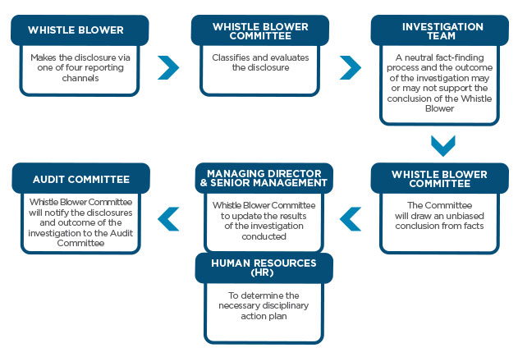
Other Aspects of Speak-up Arrangements
Key Roles
  Labour Unions
  investigators
Availability of Advice
Monitoring and Review
Training
Notes:
Labor Union-
sometimes they see whistleblowing as a right that their members should have, but sometimes they see it as one member speaking up about the wrongdoing of another member, so their role becomes complicated.
In the Netherlands and Canada, unions have demanded better whistleblowing protections for their members (Vandekerckhove 2006)
In Germany and France, unions have taken companies to court over introducing whistleblowing protections
Unions do have a positive impact on design and implementation of internal speak-up arrangements when they are involved in friendly way (Lewis and Kender, 2007, 2010; Skivenes and Trygstad, 2010)
Advice-
-independent advice helps make whistleblowing procedures fair and effective
NGO’s are increasingly filling this gap in many countries (PCAW [now Protect] in the UK, GAP in the US, TII in Ireland- WIN internationally)
Investigations
Not all claims are investigated, but all claims should be looked at and assessed as to if they merit an investigation
Monitor and Review
How this is incorporated into the policy and who conducts this step matters
TI and BSI recommend that “relevant stakeholders” be involved in review and monitoring
Training
- Those that receive and investigate reports should have proper and ongoing training to make sure the policy works

Slide 11

An Example:
Notes:
In this example:
Who – employees
What- specific examples given
How – supervisor, HR or hotline
Offers protection if made in good faith
Multiple tiers/channels
Anonymity where possible
Not mentioned (may be in full policy just not in poster)
How they are recorded?
Investigation? (promise to investigate might be implied by poster?)
Duty or right?
Availability of Advice?
Rewards?

Slide 12

Internal and External Whistleblowing
Internal reports are to someone inside the organization, e.g. a line manager, HR, or a whistleblowing champion
External reports are to anyone outside the organization, a regulator or the media
Notes:
Research has traditionally studies these as two separate types of disclosure (e.g. Jubb 1999; Detert & Burris 2007, Pohler & Luchak 2014)
Legislation makes distinctions on these areas as well, with laws having stricter requirements for external reporting in some cases, or like in the US, requiring whistleblowers to speak up externally to the SEC to draw down certain protections.

Slide 13

Internal and External Whistleblowing
Most external disclosures happen after an internal one has already happened: they are part of the same whistleblowing process
Internal
External
Notes:
Whistleblowing as a Process
Understanding whistleblowing as a process helps us to realize why people make external disclosures
It is generally accepted that wrongdoing in organisations should be stopped or corrected as early as possible, as this is in the interest of both organisation and society. This obviously requires organisational whistleblowing arrangements that succeed in encouraging workers to speak up through channels that allow organisational actors to respond to those concerns.
Whistleblowing as a protracted process is covered in week 5.

Slide 14
Employee Voice
“the discretionary provision of information intended to improve organizational functioning to someone inside an organization with the perceived authority to act, even though such information may challenge and upset the status quo of the organization and its power holders, is critical to organizational well-being yet insufficiently provided by employees, who see the risks of speaking up as outweighing the benefits.” (Detert & Burris, 2007: 869)

Slide 15
Employee Voice
3 streams
  Human Resource Management
  Employee Relations
  Organizational Behavior
Pro-social or Justice Orientation
Notes:
HRM / ER scholars tend to see voice as a way in which employees influence work practices and decisions either directly or indirectly through collective representation.
OB on the other hand tends to see voice as a matter of individual workers communicating information for the benefit of the organization
Pro-social
involving whistleblowers speaking up with the aim of improving the organization (Miceli et al 2008; Morrison, 2011; Sims and Keenan 1998).
Justice
Critics from HRM/ ER argue that this OB view has difficulties with voice as a means of challenging management (Barry and Wilkinson 2015). Hence ER scholars tend to treat whistleblowing as a form of justice-oriented voice, as opposed to pro-social voice (Klaas et al 2012, Mowbray et al 2015).
Mowbray et al (2015) try to synthesize these two views
Difference comes down to motivation for speaking up
Pro-social voice is subjective
Motivation for speaking up less important than the fact that it happens

Slide 16

Parrhesia
The Death of Socrates - Jacques-Louis David
Notes:
Parrhesia is “speaking truth to power” – a concept in Ancient Greece and used by Foucault
Frames the whistleblower as a truth teller (Andrade, 2015; Jones et al., 2005; Mansbach, 2009; Rothschild, 2013; Kenny et al., 2018)
represents an interruption of the status quo by an act of speech of a person of lower status than those holding power (Contu, 2014; Mansbach, 2009; Weiskopf and Tobias-Miersch, 2016: 650)
must involve an element of risk; the subject engages in truth telling where ‘he has ‘a specific relation to truth through frankness [and] a certain type of relationship to his own life through danger… ‘ (Foucault, 2001: 19)
Is a moral attitude
The ‘other’ in parrhesia
Statements must be made to someone (more powerful) that can hear them
Therefore parrhesia highlights the importance of the recipient
It also highlights how whistleblowing cannot be institutionalized, speak-ups are spontaneous and disruptive

Slide 17
Trust in Organizations
Trust- a state of favourable expectation regarding other people’s actions and intentions (Möllering 2001: 404)
Behavioural trust - trust in people and organisations
Competence Trust/Intentional Trust
How does trust affect a speak-up arrangement?
Notes:
Trust is the basis for:
Individual risk taking behaviour
Co-operation
Reduced social complexity
Order
Social capital
And more (Mollering, 2001).
Behavioural trust entails aspects of both competence trust and intentional trust (Nooteboom, 1996, 2006)
Competence trust: competent to stop the wrongdoing, i.e. the recipient has the required technical, cognitive, and communicative competencies
Intentional trust: a whistleblower trusts the recipient will forego opportunism and instead act honestly, truthfully, and shield the whistleblower from potential harm (the whistleblower expects the recipient to act)
Trust and Speak-ups
speak-up operators attempt to support trust between whistleblower, speak-up operator, and the organisation.
whistleblowing happens when the person disclosing the wrongdoing cannot stop it herself and so the whistleblower (truster) expects the recipient (trustee) to do so.

Slide 18
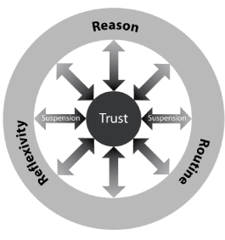
Möllering’s Trust Model
trust is characterized by insufficient information and emotionally enabled leaps of faith (Möllering 2013: 291)
http://www.mpifg.de/pu/workpap/wp06-5/wp06-5.html
Notes:
Möllering (2001) further develops the notion of ‘trust as expectation’ by revisiting Simmel’s thinking on trust. Accordingly, trust is a mental process that encompasses the elements of expectation, interpretation, and suspension.
He highlights that trust isn’t without risk. There is a ‘leap of faith’ involved, which is why he introduces suspension into the model
trust as ‘a state of favourable expectation’ is an outcome of a dynamic combination of cognitive interpretations of lived experience and non-cognitive suspensions which amount to a bracketing or indifference towards what remains uncertain or unknown.
Both McEvily (2011) and Möllering (2013) assert that if risk would be fully calculable there would be no need for trust

Slide 19
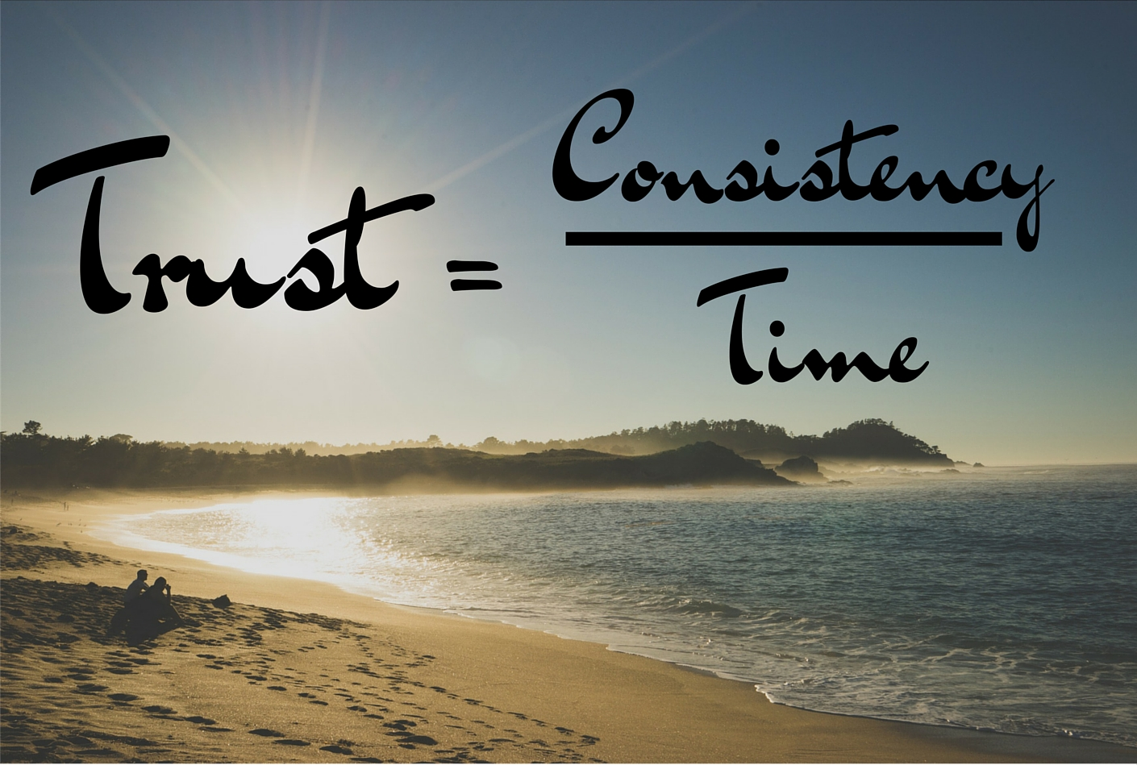
Trust and Time
Trust takes time to build, and can be undone much more quickly than it is built
Trust evolves through interactions
Previous Experience is Crucial
Notes:
Trust Treated as Static
Trust tends to be treated as a static characteristic of organisational culture (Holtzhausen 2009, Lewis 2011, Near and Miceli 1985, Uys 2008).
Nooteboom (1996) critiques transaction costs economics (TCE) by arguing that while TCE acknowledges the importance of time lapses, parameters of trust are nevertheless assumed as unchanging
Trust Treated as Dynamic
The wider field of organisation studies sees trust as a process in which time is a key dimension for examining how trust happens and evolves through interactions between truster and trustee (Bachman et al 2015; Laan et al 2011; Möllering 2001, 2006, 2013; Nooteboom 1996, 2006; Saunders et al 2014).
Trust is continuous and dynamic rather than momentary and static (Möllering 2013).
Previous Experience is Crucial
Earlier experiences can provide small cues that through a process of sense-making are subsequently enlarged through accumulation of evidence, which may lead to behavioural changes instantiating alternative or additional forms of trust (Adobor, 2005; Jagd, 2010).

Slide 20
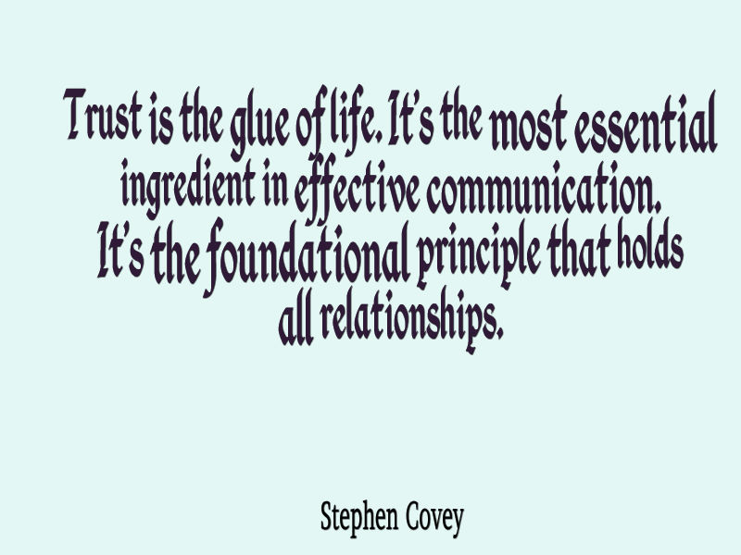
Trust in Organizations
Notes:
Interviewees acknowledged that if they did not establish trust the employee would speak-up externally, which was undesirable.
Ways that those responsible for speak-up arrangements have tried to establish/maintain trust
Simplify the procedure
Have various levels of interaction
emphasize the independence of the compliance office
Balance between obligation to whistleblower and organization
Don’t over-promise on anonymity
Communicate results post-investigation
respond quickly and frequently to questions

Slide 21
How do People Speak Up?
Corporate Ethical Virtue Model (Kaptein, 2011)
  Clarity
  Congruency
  Feasibility
  Supportability
  Transparency
  Discussability
  Sanctionability
Notes:
Full Reference is Kapteain, M (2011) ‘From Inaction to External Whistleblowing: The influence of ethical culture of organizations on employee responses to observed wrongdoing’, Journal of Business Ethics, vol 98: pp 513-530
Clarity- the extent to which the organization makes ethical expectations (values, norms, principles) concrete and understandable to employees.
Congruency- the extent which manager apply organizational standards to their own behavior
there are 2 levels of congruency, that of local management and that of senior management.
Feasibility- the extent to which the organization makes sufficient time, budgets, equipment, information, and authority available to enable employees to fulfil their responsibilities
Supportability- the extent to which the organization stimulates identification with the ethics of the organization among employees
Transparency- the degree to which wrongdoing and its consequences are visible to those who can act upon it internally, includes wrongdoers, colleagues, supervisors, managers, and subordinates.
Discussability- the extent to which ethical issues, such as ethical dilemmas and alleged wrongdoing, can be discussed internally
Sanctionability- the extent to which employees believe that unethical behaviour will be punished and ethical behaviour will be rewarded.

Slide 22
Corporate Ethical Virtue Model (con’t)
Employee responses to wrongdoing
  Inaction
  Confronting he wrongdoer(s)
  Reporting to management
  Calling an internal hotline
  External whistleblowing
Notes:
Clarity
is positively related to:
Confrontation
Reporting to management
Calling a hotline
Negatively related to:
Inaction
External whistleblowing
Congruency of Local Management
Is positively related to:
Reporting to management
Is negatively related to:
Calling a hotline
External whistleblowing
Confrontation
No relation to:
Inaction
Congruency of Senior Management
Positively Related to:
Calling a hotline
Negative relation to:
External whistleblowing
Confrontation
No relationship with:
Inaction
Reporting to management
Feasibility
Positive relationship to:
Calling a hotline
External whistleblowing
No relationship for:
Inaction
Confrontation
Reporting to management
Supportability-
Positively related to:
Confrontation
Reporting to management
Calling a hotline
Negatively related to:
Inaction
No relation:
External whistleblowing
Transparency-
Positively related to:
Inaction
External whistleblowing
Negatively related to:
Confrontation
Reporting to management
No relationship:
Calling a hotline
Discussability-
Positively related to:
Confrontation
Reporting to management
Negatively related to:
Inaction
External whistleblowing
Calling a hotline
Sanctionability
Positively related to:
Confrontation
Reporting to management
Calling a hotline
Negatively related to:
Inaction
External whistleblowing

Slide 23
Whistleblowing as a Protracted Process (PCAW [now Protect] 2013)
 | Internal | External | Union | Total
first attempt | 778 (89.6%) | 75 (8.6%) | 15 (1.7%) | 868 (100.0%)
second attempt | 350 (72.3%) | 115 (23.8%) | 19 (3.9%) | 484 (100.0%
third attempt | 85 (59.9%) | 51 (35.9%) | 6 (4.2%) | 142 (100.0%)
fourth attempt | 10 (45.5%) | 11 (50.0%) | 1 (4.5%) | 22 (100.0%)
Notes:
Kaptein’s research however does not consider the possibility of speaking up to different recipients in a sequence
Interviewing more than 200 whistleblowers in the US, Rothschild and Miethe (1999) find that ‘[many] came to their whistle-blowing almost by accident’ (p. 119). Employees raised their concern with their line manager and then further with senior management, each time believing the recipient would step in to correct the situation. Only after voicing their concern internally twice did they consider going to authorities outside the organisation
Public Concern at Work 2013 traced for 868 cases, and found that most whistleblower speak up at least twice, with some speaking up up to 4 times. (Chart above shows who they disclosed to)

Slide 24
Implications
Internal and External whistleblowing are part of the same process: employees speak up internally first before going external in most cases
Whistleblowers seek out increasingly independent recipients if their speak-up is not handled properly
Higher managers and external recipients should be wary of promising anonymity, as the speak-up has likely been raised to someone else previously
Notes:
Understanding speak-ups as a protracted process helps to create speak up arrangements that are more practical and useful
Understanding how culture influences the process of speaking up can help in designing and implementing speak-up arrangements that work in practice.

Slide 25
Best Practice In Speak-up Arrangements
Offer a variety of speak-up channels
Involve more than one function in your speak-up arrangement
Build trust through speak-up arrangements
Be responsive
Be aware of the barriers to responsiveness
Develop strategies to circumvent barriers to responsiveness
Notes:
All taken from the Designing and Implementing Effective Speak-up Arrangements Report by ACCA 2016
https://www.wbs.ac.uk/wbs2012/assets/PDF/downloads/press/The%20Whistleblowing%20Guidelines.pdf.
And: Kenny, K., Vandekerckhove, W., & Fotaki, M. (2019) The Whistleblowing Guide: Speak-up Arrangements, Challenges and Best Practices. Wiley: Chichester.
Variety of Channels:
• Informal channels, • Question channel, • Key internal persons, • Internal hotline, • External hotline, • External Ombuds-person, • External independent advice channel, • IT-based channels, • Email and web applications.
Each has it’s own limitations so combining them reduces the weaknesses of each
More than one function:
- Organizations with more than one function are more responsive (see week 7 for barriers to responsiveness)
E.g. one function is to ‘mantle’ the voicing employee and follow up their well-being, the other function investigates the potential wrongdoing.
Build Trust
Create and implement speak-up practices that evolve over time, and are supported by the independence of speak-up operators
Speak-up operator should have protocols and policies that specify rules for managers at different levels about how, when, and to whom within the organisation a concern raised by an employee must be escalated
Operator should be a specialist role and not a ‘side job’ that is marginal and secondary to other daily duties.
Be Responsive
Respond to concerns, even if they first appear to be (or actually are) grievances
Investigate concerns, at least conduct some preliminary investigation to see if the matter requires further attention
Communicate at every step (where possible)
Intervene and stop the wrongdoing as early as possible
Barriers to Responsiveness
Inability to share the results of an investigation due to legal limitations
Not having the contact information of an anonymous whistleblower
Invisibility of the response (e.g. sanctions)
Strategies to circumvent barriers
give them an indicative timescale of follow up activities
inform them of legal limitations that prevent you from providing a detailed response.
communicating widely about concerns that were not related to wrongdoing
engaging with the voicing employee in finding a solution to the problem
reporting on the aggregated speak-up events
being responsive to concerns that do not lead to investigations or sanctions
-

Slide 26
Best Practice (con’t)
Shape and coordinate attitudes to responding
Involve third parties wherever possible
Record all speak-up events
Report
Consider national and organisational culture
Provide access in different languages
Notes:
Shape and Coordinate Attitudes
continuously reinforce the message to managers at all levels that responding to concerns is part of their role
restrict the discretion about how to respond to speak-up attempts
Involve third parties whenever possible
Union
Record all events
Even events that don’t lead to investigation or sanction
Useful for recognising patterns of concerns resulting from underlying problems.
Useful for collecting data for training purposes
Useful for monitoring speak-up climates and most-used channels
Report
publish aggregated numbers of speak-up events in the annual report
Leads to positive interest from investors
Promotes internal transparency
Culture
National/regional culture has an impact on how people prefer to speak up/which channels they use
Multiple Languages
Essential for MNEs
Allows for choice of local or shared language to be used for increased communication
s and independent advice lines

Slide 27
Best Practice
Policy
Oversight
Review
Notes:
PCAW [now Protect] published best practice based on responses to their First 100 program:
http://www.pcaw.org.uk/content/5-latest/2-news/9-pcaw-launches-new-best-practice-guide-based-on-insight-from-first-100-signatories/PCAW_Best%20Practice%20FINAL.pdf
According to PCAW/ Protect, a good policy:
Identifies the types of concerns to which the procedure relates, giving examples relevant to the employee
Includes a list of the persons within the organisation and external bodies, such as regulators, with whom workers can raise concerns; Provides an assurance to the worker that he/she will not suffer detriment for having raised a concern, unless it is later proved that the information provided by the worker was, to his or her knowledge, false
Provides an assurance to the worker that his or her identity will be kept confidential if the worker so requests, unless disclosure is required by law
Requires that the worker raising a concern be told:
how the concern will be handled,
an estimate of how long the investigation will take,
the outcome of the investigation (where appropriate),
that if the worker believes he/she is suffering detriment for raising a concern he/she should report this,
and that he/she is entitled to independent advice;
Includes sanctions for those who subject an individual to detriment because he/she has raised a concern.
Beyond having written procedures which are promoted among staff, organisations should ensure that there is sufficient oversight of the arrangements. An organisation following the Code of Practice:
Identifies how and when concerns should be recorded;
Ensures, through training at all levels, the effective implementation of the whistleblowing arrangements;
Identifies the person with overall responsibility for the effective implementation of the whistleblowing arrangements;
Makes provision for the independent oversight of whistleblowing arrangements by the Board, the Audit or Risk Committees or an equivalent body;
When publishing annual reports, includes information about the effectiveness of whistleblowing arrangements. This should include staff awareness, trust and confidence in the arrangements; the number and types of concerns raised; and any relevant litigation
Once an organisation has put whistleblowing arrangements in place and established effective oversight, it is vital to review these arrangements periodically. Under the Code of Practice these reviews should consider:
The number and types of concerns raised and the outcomes of investigations;
Feedback from individuals who have used the arrangements;
Any complaints of victimisation or failure to maintain confidentiality;
A review of other existing reporting mechanisms, such as fraud, incident reporting or health and safety reports;
A review of other adverse incidents that could have been identified by staff (e.g. consumer complaints, publicity or wrongdoing identified by third parties);
A review of any relevant litigation;
A review of staff awareness, trust and confidence in the arrangements.

Slide 28

Benefits of an Effective Speak Up Arrangement
For the Organization
For the Employee
For Society
Notes:
Organization
Prevents Financial Loss
Prevents reputational loss
Saves time and money on legal battles
Creates organisational trust
Employee
Prevents retaliation
Makes reporting more effective (stops the wrongdoing sooner)
Society
Protects public interest
. Maintains trustworthy institutions

Slide 29
Responsiveness
“[it] is management’s response that shapes the potential whistle-blower’s subsequent actions. Specifically, our interviews revealed a common pattern in which management’s efforts to discredit or retaliate against the claimant become the major catalyst for the political transformation of the concerned employee into a “persistent resister” (Rothschild & Miethe 1999: 119-120)
Notes:
We know that ‘responsiveness’, or the assumed willingness of the assumed target of the information to listen and respond, is an important influence in whether someone will speak out in the first place, and whether the outcome is successful (Burris 2012, Rothschild & Miethe 1999).
It is perceived response, and not actual response that matters

Slide 30

Barriers to Responsiveness
anonymous concerns
legal limitations
invisibility of response
Notes:
Anonymous concerns
If the identity of the person making the speak up is not known, it is hard to communicate updates, progress or results unless the organization wants to broadcast the issue to all employees, which is sometimes not feasible.
Anonymous concerns are often reported through a made up email address, and the sender does not check it again after communicating the issue, even if the recipient responds.
If the concern is raised anonymously through a hotline, there is no signalling that the report was even received by the company.
Legal Limitations
Data protection and Privacy Laws require that personal data is protected, and this limits the amount of communication that can happen around certain disclosures
Conveying details can inhibit legal proceedings against a wrongdoer
If the speak-up is mistaken, defamation laws also prevent communicating details as the wrongdoer my be easily identified.
Invisibility of Response
Particularly with anonymous disclosures, if there is no way to get in touch, the response may not be known (such as reprimand or disciplinary action against wrongdoes)
it is the perceived response rather than the real response that matters for individual and collective sense making

Slide 31

Strategies for Overcoming Barriers
Build Trust by handling speak-ups appropriately and consistently
Communicate widely about broad concerns
Communicate limitations up front and often
Be flexible and use common sense
Notes:
Strategies to circumvent barriers
Where possible, give them an indicative timescale of follow up activities
inform them of legal limitations that prevent you from providing a detailed response.
communicating widely about concerns that were not related to wrongdoing- an example of this was a CEO who had a blog on the company intranet where he responded to anonymous concerns and questions
engaging with the voicing employee in finding a solution to the problem
reporting on the aggregated speak-up events
PCaW/ Protect Best Practice tips:
Encourage openness: openness makes it easier for the employer to assess the issue, work out how to investigate the matter and obtain more information.
Treat anonymous disclosures as a cultural barometer and, where possible, offer to handle the matter confidentially.
Confidence is key: handle the concerns you do get well. Staff will remember it and share the experience with colleagues.
Build staff trust: written assurances alone are not enough. Use regular positive messaging from managers and practical examples of managers dealing sensitively with issues to build staff trust.
Manage expectations: be realistic when managing expectations around confidentiality. In smaller organisations, where the staff member was the only witness, or where they have already made attempts to raise the concern elsewhere, maintaining confidentiality may not be possible. In these circumstances it is essential that you reiterate that reprisal will not be tolerated.
Keep promises: if you do make promises, keep them. Explain if circumstances change.
Support the whistleblower: acknowledge and respect any fear of reprisal. Give assurances that bullying or victimisation will not be tolerated and encourage staff to report it if it occurs.
Be flexible and use common sense: what may be appropriate for one part of an organisation might not work in another

Slide 32

Facilitating Responsiveness
“We believe that […] far too many organizations are caught in an apparent paradox in which most employees know the truth about certain issues and problems within the organization yet dare not speak that truth to their superiors” (Morrison & Milliken, 2000: 706)
Notes:
Research has shown that in order for employees for express their concerns, fhey must believe that doing so will be both effective and not too personally costly {Ashford et aL, 1998; Miceli & Near, 1992; Withey & Cooper, 1989).
There are aspects of Organizational culture that lead to organizational silence and mistrust:
Organizational Silence (Morrison & Milliken, 2000)- what creates a culture of silence
Managers' Fear of Negative Feedback
Managers' Implicit Beliefs
Conditions Fostering These Beliefs
Organizational Structures, Policies, and Practices
The Creation of Shared Percepfions via Collective Sensemaking
Distortions in the Sensemaking Process
Direcf Effecfs of Demographic Dissimilarity

Slide 33
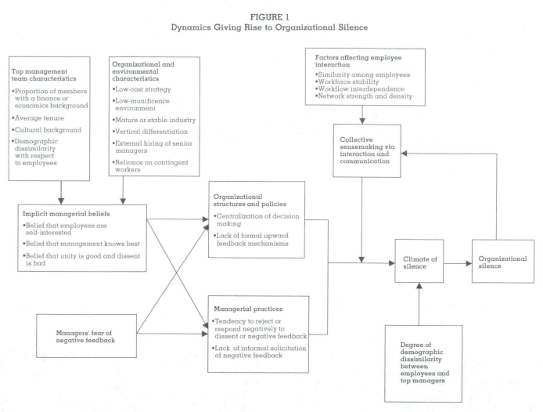
SOURCE: Morrison, E, & Milliken, F (2000), 'Organizational silence: A barrier to change and development in a pluralistic world', Academy Of Management Review, 25, 4: 709
Notes:
Morrison, E, & Milliken, F 2000, 'Organizational silence: A barrier to change and development in a pluralistic world', Academy Of Management Review, 25, 4: 709

Slide 34
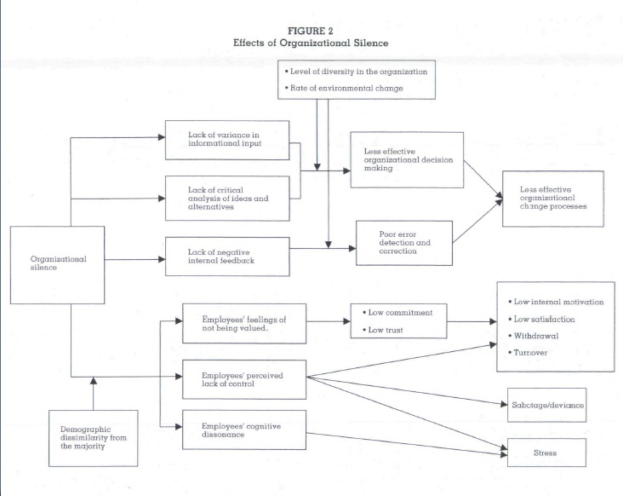
SOURCE: Morrison, E, & Milliken, F (2000), 'Organizational silence: A barrier to change and development in a pluralistic world', Academy Of Management Review, 25, 4: 709
Notes:
Morrison, E, & Milliken, F 2000, 'Organizational silence: A barrier to change and development in a pluralistic world', Academy Of Management Review, 25, 4: 718
Impacts-
Effects on Organizational Decision Making and Change Processes – decisions are better when there are multiple, diverse voice providing options
Effects on Employee Cognitions, Attitudes, and Behavior- silence can lead to employees who feel they are not valued, employees who perceive they lack control, and employees who experience cognitive dissonance.
Cultivating ethical and open cultures (per Kaptein, see week 5) avoids this culture of silence and makes it safe for employees to speak up.

Slide 35
Using Speak-Up Data
recognising patterns of concerns resulting from underlying problems
collecting data for training purposes
monitoring speak-up climates and most-used channels
Notes:
Collecting, documenting and using speak up data can be useful to organizations in many ways
By recording information in a centralized way, it can become evident where patterns of issues arise
This requires that issues raised are recorded even if there is no wrongdoing found
Review of the data regularly will help these patterns emerge
Corrective action, or just increased communication can help solve issues, create an open culture and help build trust
Training
By basing training on real issues (so long as it doesn’t implicate individuals) speak up operators get a better sense for how to handle speak-ups
By seeing where repeat issues arise, speak-up operators can be trained on how to better handle specific types of speak ups
Monitoring Climates and Channels
- By recording data, it can be seen which channels are being used and where resources are needed, it can also help signify cultural change, for example if at first employees use a hotline but later speak up in person to a manager, this may signal that the culture has changed and employees feel safe speaking up without retaliation

Slide 36
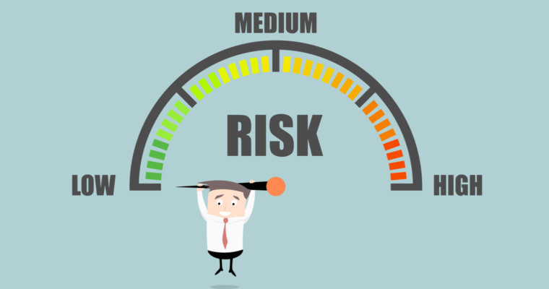
Risks To Using Speak Up Data
First Mover Disadvantage
Confusion from investors and Stakeholders
Misinterpretation of results
Notes:
First Mover Disadvantage
By publishing speak up data an organization is making internal issues transparent to external stakeholders. If stakeholders are not used to this they may think issues are more dire than they are.
Confusion
Investors and stakeholders may not know how to react to speak-up information or may take it as a sign that there are grand problems in the organization
Misinterpretation
- Results have to be interpreted: for example, if there is a drop in the number of speak-ups, does that mean that there are less issues? Or that the employees don’t trust the process. Simply recording the data won’t be able to tell you which is the case.

Slide 37
PCAW/ Protect Best Practice Tips
Be aware: numbers of formal whistleblowing reports do not tell the whole story.
Keep staff informed: be open and transparent about the themes of concerns raised and the remedial action taken.
Consider
all of your reporting mechanisms as a whole
Cultural indicators such as staff attitudes, trust and confidence
The use of grievance and disciplinary proceedings following whistleblowing

Slide 38
External whistleblowing
When disclosures cannot be made within the organization, the employee should seek help in the first instance- consult advocacy group advice, legal advice, support from loved ones.
Useful guidance from: Devine & Maassarani (2011)
And see https://www.whistleblowingimpact.org for research resources
Notes:
Devine, T. and Maasarani, T. (2011). The Corporate Whistleblower’s Survival Guide. Government Accountability Project: Washington, D.C.
Munro, I. (2017). “Whistle-blowing and the politics of truth: Mobilizing ‘truth grames’ in the WikiLeaks case.” Human Relations 70(5): 519-543.
Advice from: Transparency International Ireland, Government Accountability Project

